Slide 1
Project Title
Group Members

Slide 2
1 - 2 sentence description of project

Slide 3
Inspiration
Artwork, Images, anything that inspired this project idea
Artwork, Images, anything
that inspired this project idea

Slide 4
Data you will use

Slide 5
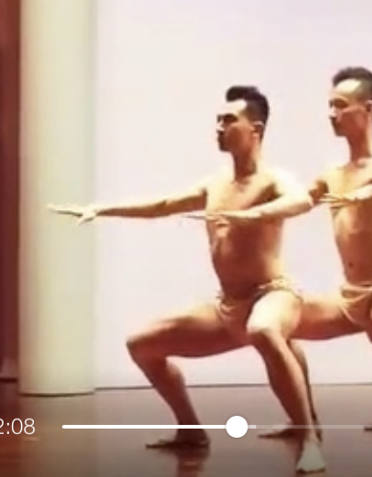
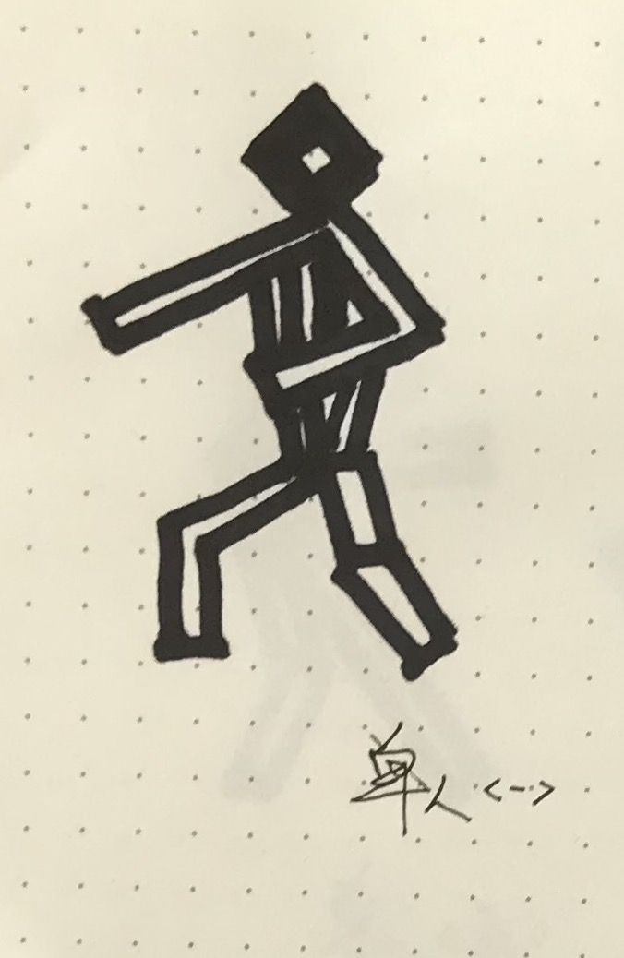
How you will translate the data?
(Example)

Slide 6
Form Sketches
Sketches of final form
Sketches of final form idea

Slide 7
Timeline for Completion (What will you do for the rest of the week?)

Slide 8
Thank you

